Slide 1
Maths
Unit 4 – Addition and Subtraction
WALT:
6Nc.02 – Recognise the use of letters to represent quantities that vary in addition and subtraction calculations.

Slide 2



WALT: Recognise the use of letters to represent quantities that vary in addition and subtraction calculations.
With support, I can answer questions that use letters to represent quantities.
Independently, I can answer questions that use letters to represent quantities.
I can specialise by showing all the possible values of a variable.

Slide 3
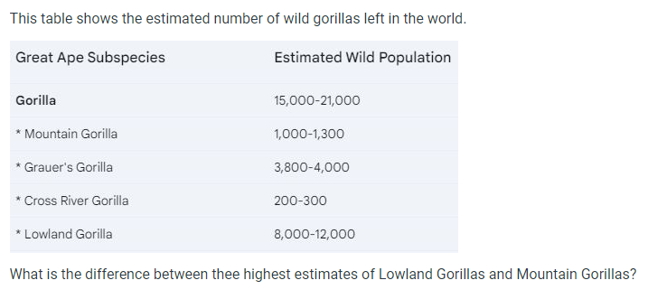
WALT: Recognise the use of letters to represent quantities that vary in addition and subtraction calculations.
Retrieval Practice

Slide 4
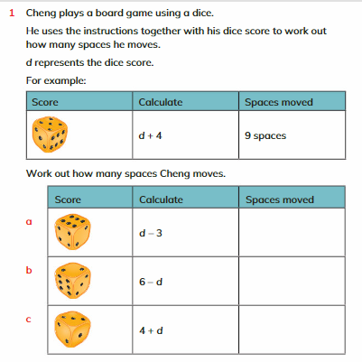
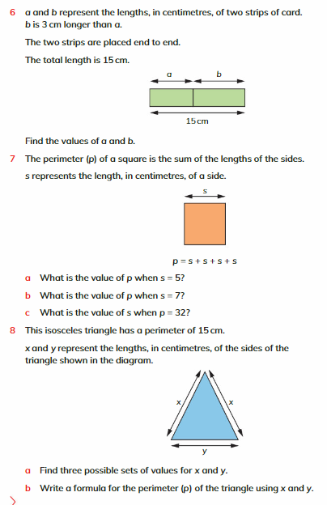
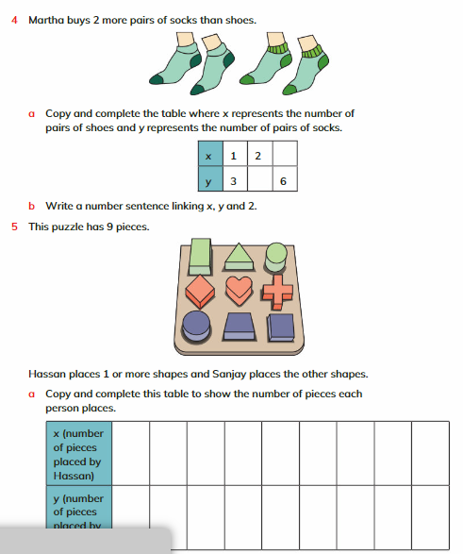
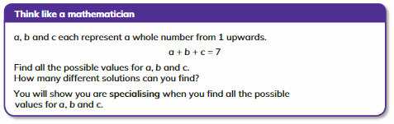
WALT: Recognise the use of letters to represent quantities that vary in addition and subtraction calculations.
Pg. 58 - 61

Slide 5
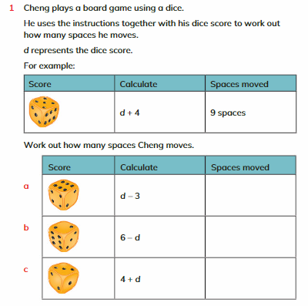
WALT: Recognise the use of letters to represent quantities that vary in addition and subtraction calculations.
3
4
7

Slide 6
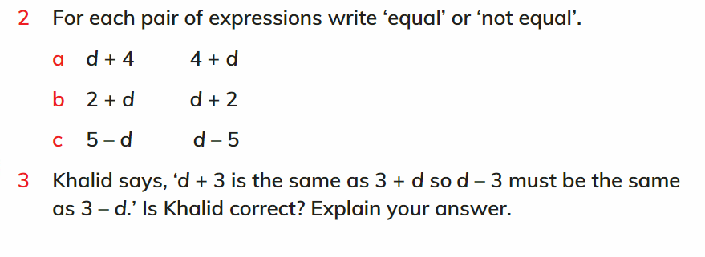
WALT: Recognise the use of letters to represent quantities that vary in addition and subtraction calculations.
equal
equal
not equal
Khalid is incorrect. Due to the commutative law is does not matter which number is written first in addition questions but it does in subtraction questions.

Slide 7
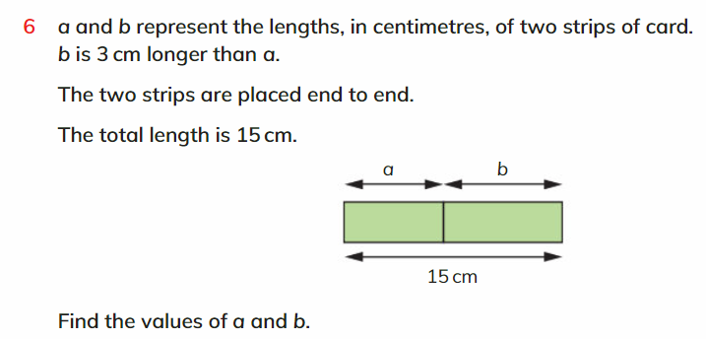
WALT: Recognise the use of letters to represent quantities that vary in addition and subtraction calculations.
a = 6cm
b = 9cm

Slide 8
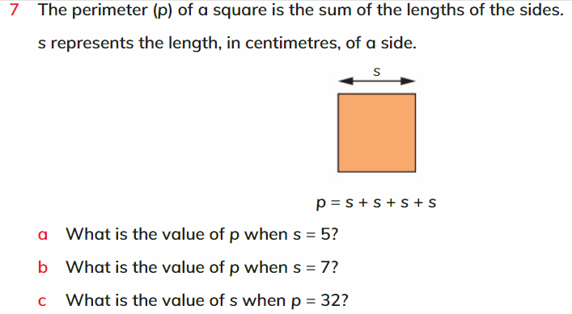
WALT: Recognise the use of letters to represent quantities that vary in addition and subtraction calculations.
20
28
8

Slide 9
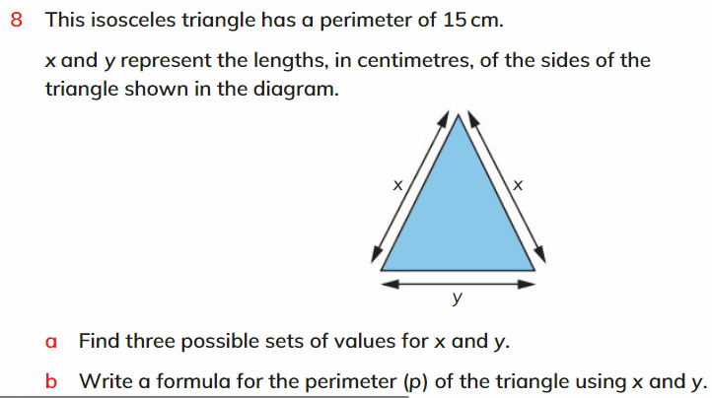
WALT: Recognise the use of letters to represent quantities that vary in addition and subtraction calculations.
Y = 13
X = 1
Y = 11
X = 2
Y = 9
X = 3
Y = 7
X = 4
Y = 3
X = 6
Y = 1
X = 7
x + x + y = 15

Slide 10
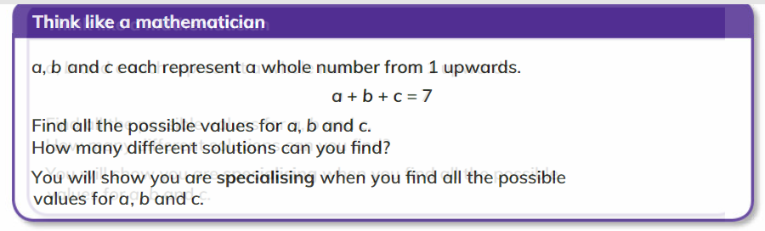
WALT: Recognise the use of letters to represent quantities that vary in addition and subtraction calculations.

Slide 11
WALT: Recognise the use of letters to represent quantities that vary in addition and subtraction calculations.
With support, I can answer questions that use letters to represent quantities.
Independently, I can answer questions that use letters to represent quantities.
I can specialise by showing all the possible values of a variable.

Slide 12
Plenary
WALT: Recognise the use of letters to represent quantities that vary in addition and subtraction calculations.
If 5b = 20 what does b = ?
b =
4
Why do you think we don’t use the multiplication sign “x” ?

